Slide 1

Probability and Statistics
(Software Engineering)
Instructor
Dr. Bakhtawar

Slide 2
Regression
Describes how an independent variable is associated with the dependent variable.
Both variables are different.
To fit the best line and estimate one variable based on another variable.

Slide 3
Regression
As we know, linear regression is used to model the relationship between two variables. Thus, a simple linear regression equation can be written as: Y = a + bX Where,
Y = Dependent variable
X = Independent variable

Slide 4

Regression
$a=\frac{\text{ [(∑}\text{y}\text{)(∑}\text{x}\text{2}\text{) – (∑}\text{x}\text{)(∑}\text{xy}\text{)] }}{\text{[}\text{n}\text{(∑}\text{x}\text{2}\text{) – }{\text{(∑}\text{x}\text{)}}^{2}\text{]}}$
$$b=\frac{\text{[}\text{n}\text{(∑}\text{xy}\text{) – (∑}\text{x}\text{)(∑}\text{y}\text{)]}}{\text{[}\text{n}\text{(∑}\text{x}\text{2}\text{) –}{\text{(∑}\text{x}\text{)}}^{2}\text{] }}$$

Slide 5
Least Square Method
The least square method is the process of finding the best-fitting line of best fit for a set of data points by reducing the sum of the squares of the offsets (residual part) of the points from the curve. During the process of finding the relation between two variables, the trend of outcomes are estimated quantitatively.

Slide 6
Least Square Method
This process is termed as regression analysis. The method of curve fitting is an approach to regression analysis. This method of fitting equations which approximates the curves to given raw data is the least squares.

Slide 7
Least Square Method
The least-squares method is a crucial statistical method that is practiced to find a regression line or a best-fit line for the given pattern. This method is described by an equation with specific parameters. The method of least squares is generously used in evaluation and regression. In regression analysis, this method is said to be a standard approach for the approximation of sets of equations having more equations than the number of unknowns.

Slide 8
Least Square Method
The method of least squares actually defines the solution for the minimization of the sum of squares of deviations or the errors in the result of each equation. Find the formula for sum of squares of errors, which help to find the variation in observed data.

Slide 9
Least Square Method
The least-squares method is often applied in data fitting. The best fit result is assumed to reduce the sum of squared errors or residuals which are stated to be the differences between the observed or experimental value and corresponding fitted value given in the model.

Slide 10
Least Square Method Formula
The least-square method states that the curve that best fits a given set of observations, is said to be a curve having a minimum sum of the squared residuals (or deviations or errors) from the given data points. Let us assume that the given points of data are (x₁, y₁), (x₂, y₂), (x₃, y₃), …, (x_{n}, y_{n}) in which all x’s are independent variables, while all y’s are dependent ones. Also, suppose that f(x) is the fitting curve and d represents error or deviation from each given point.

Slide 11
Least Square Method Formula
Now, we can write:
d₁ = y₁ − f(x₁)
d₂ = y₂ − f(x₂)
d₃ = y₃ − f(x₃)
…..
d_{n} = y_{n} – f(x_{n})

Slide 12
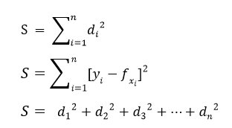
Least Square Method Formula
The least-squares explain that the curve that best fits is represented by the property that the sum of squares of all the deviations from given values must be minimum, i.e:

Slide 13
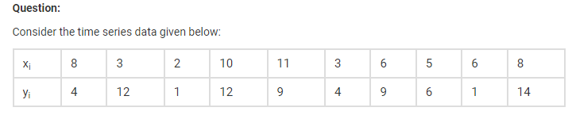
Least Square Method

Slide 14
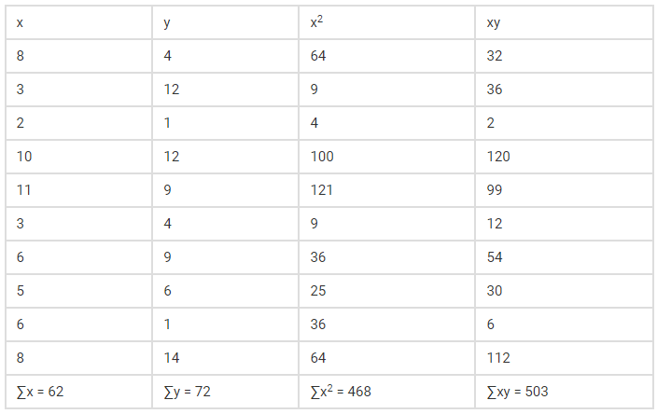
Least Square Method

Slide 15
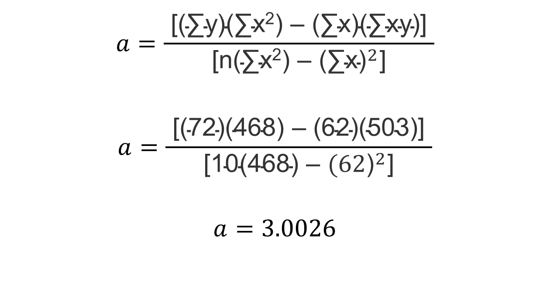
Least Square Method
$$a=\frac{\text{ [(∑}\text{y}\text{)(∑}\text{x}\text{2}\text{) – (∑}\text{x}\text{)(∑}\text{xy}\text{)] }}{\text{[}\text{n}\text{(∑}\text{x}\text{2}\text{) – }{\text{(∑}\text{x}\text{)}}^{2}\text{]}}$$
$$a=\frac{\text{ [(}\text{72}\text{)(}\text{468}\text{) – (}\text{62}\text{)(}\text{503}\text{)] }}{\text{[}\text{10}\text{(}\text{468}\text{) – }{\text{(62}\text{)}}^{2}\text{]}}$$
$$a=3.0026$$

Slide 16
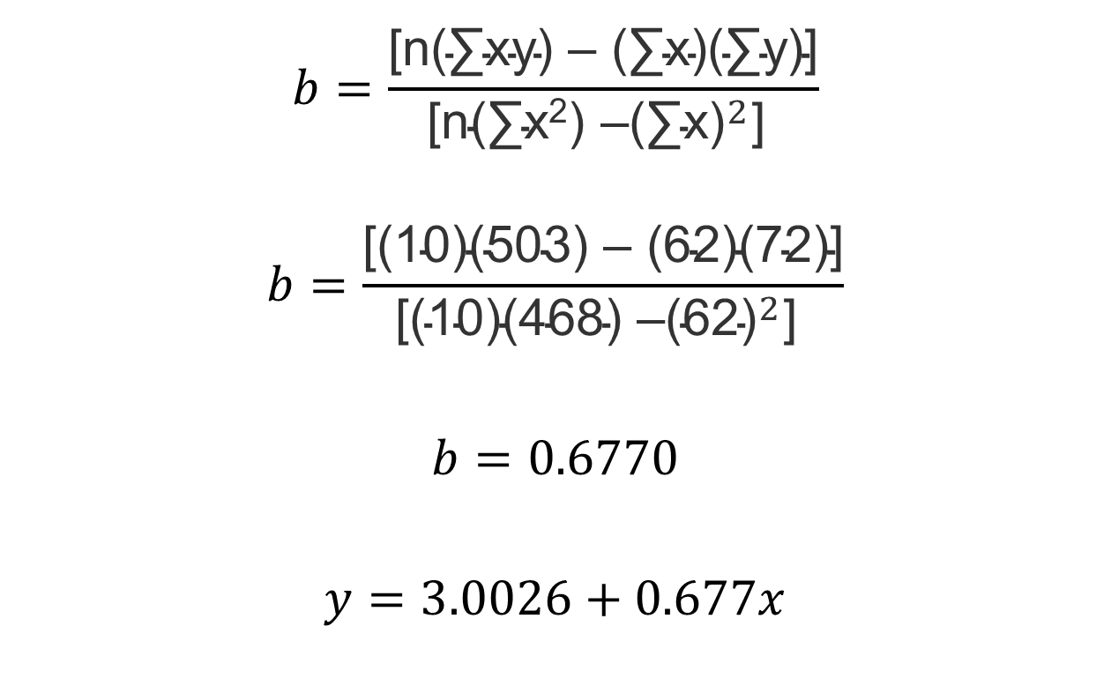
Least Square Method
$$b=\frac{\text{[}\text{n}\text{(∑}\text{xy}\text{) – (∑}\text{x}\text{)(∑}\text{y}\text{)]}}{\text{[}\text{n}\text{(∑}\text{x}\text{2}\text{) –}{\text{(∑}\text{x}\text{)}}^{2}\text{] }}$$
$$b=\frac{\text{[}\text{(10)}\text{(}\text{503}\text{) – (}\text{62}\text{)(}\text{72}\text{)]}}{\text{[}\text{(10)}\text{(}\text{468}\text{) –}{\text{(}\text{62}\text{)}}^{2}\text{] }}$$
$$b=0.6770$$
$$y=3.0026+0.677x$$

Slide 17
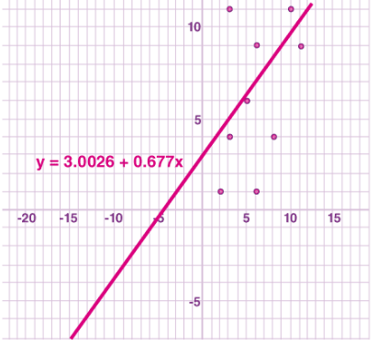
Least Square Method

Slide 18
Least Square Method
Now, we can find the sum of squares of deviations from the obtained values as:
d₁ = [4 – (3.0026 + 0.677*8)] = (-4.4186)
d₂ = [12 – (3.0026 + 0.677*3)] = (6.9664)
d₃ = [1 – (3.0026 + 0.677*2)] = (-3.3566)
d₄ = [12 – (3.0026 + 0.677*10)] = (2.2274)
d₅ = [9 – (3.0026 + 0.677*11)] =(-1.4496)
d₆ = [4 – (3.0026 + 0.677*3)] = (-1.0336)

Slide 19
Least Square Method
d₇ = [9 – (3.0026 + 0.677*6)] = (1.9354)
d₈ = [6 – (3.0026 + 0.677*5)] = (-0.3876)
d₉ = [1 – (3.0026 + 0.677*6)] = (-6.0646)
d₁₀ = [14 – (3.0026 + 0.677*8)] = (5.5814)
∑d² = (-4.4186)² + (6.9664)² + (-3.3566)² + (2.2274)² + (-1.4496)² + (-1.0336)² + (1.9354)² + (-0.3876)² + (-6.0646)² + (5.5814)² = 159.27990

Slide 20
Thank you!

